Slide 1
Teen Court Database
Team TwoCents: Bobby Reilly and Andrew Thompson

Slide 2
Sponsor
Lawrence County Teen Court
Director Marlene Todd
Based out of Deadwood, SD
Teen Courts provide a place for first time offenders to assume responsibility for their actions and keep their record clean.
There are 9 courts within South Dakota and around 1,250 in the US.

Slide 3
Client Problem
Using JAT Trax Studio’s Teen Court Database since 2000
Problems with JAT Trax Studio’s software
Uses old version of Microsoft Access, can not be installed on newer PCs
Only accessible from one PC
Limited ability to gather statistics to send to national youth court and local legislatures

Slide 4
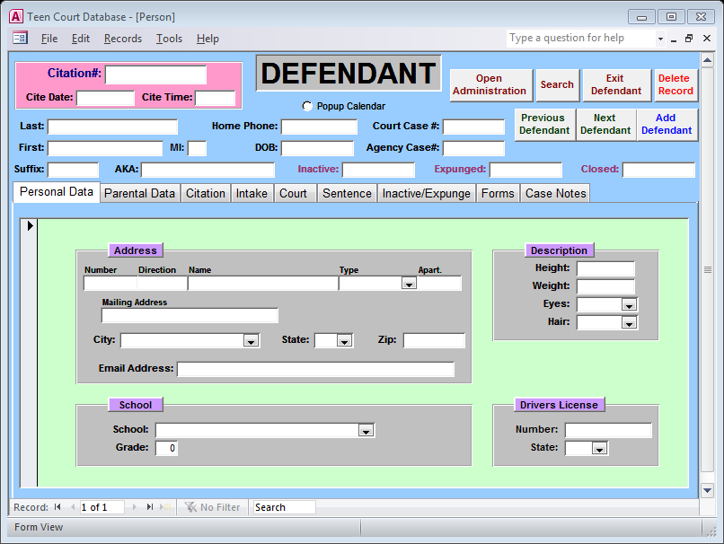
Current Software

Slide 5
Project Analyst
Distributed Application | Web-based Application
Pros:
Packaged software with self installer | Can access anywhere
Data more secure if used on an intranet | Easier to gather national statistics
 | No chance to miss updates
Cons:
Possible to miss updates | Harder to secure
Each court program responsible for own servers | Single organization has to cover all costs
Statistics still difficult to gather nationally
The second concept was chosen to be developed.

Slide 6
Requirements
Options within the database need to be highly generic for individual courts to customize and adjustable.
Privacy of all juveniles within the court system is a large concern and must be kept secure.
Ability to easily gather statistics on a state and national level

Slide 7
User Stories
Handle different search criteria (citation #, name, etc.)
Allow order and values for selection to be adjustable by court
Able to submit statistics to national organization
Store large amounts of information for the defendants
Accessible only by Teen Court staff
Able to send out custom surveys
Specify who receives the survey via state or court
Ability to track changes made through the database

Slide 8
Risk Management
Dealing with juveniles, charges must be kept confidential
Data security
Secure connections
Accessing non-approved court data
Sanitize input to prevent SQL injection
Data normalization
Minimizes redundancy
Provides as consistent data as possible
Cross platform and browser support
User log

Slide 9
Use Case – Application Administrator
Site Administrators will be able to:
Create and delete courts with confirmation from the Court Administrator
Create and modify all users
Pull statistics on National and State levels

Slide 10
Use Case – Court Administrator
Court Administrators will be able to:
Set information about the court such as state, town(s), logo, schools, court types, court personnel, volunteers, court mailing information, and court document information
Set information for court cases such as valid marks for identification, statute number, title, type, and workshop titles
Manage personnel access levels
Create reports
Pull statistics for the court

Slide 11
Use Case – Court Manager
Court Manager will be able to
Add and modify Defendant and Volunteer information
Create Court Docket and manage Jury Pool
View and create reports
Pull statistics for the court

Slide 12
Use Case – Court User
Court Users will be able to:
View Defendant and Volunteer information
View Court Docket
View and create reports
Pull statistics for the court

Slide 13
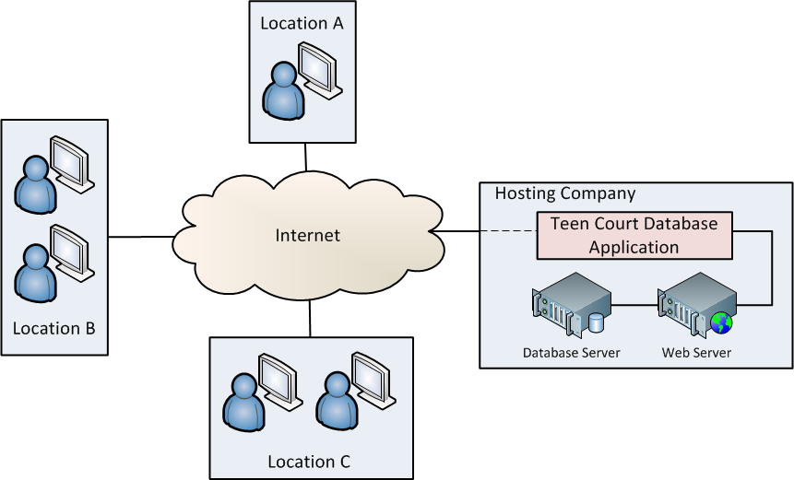
System Architecture
Web-based Application
Accessible with any internet connected device

Slide 14
Application Design
Apache HTTP web server running on Linux OS
Web application will be built using:
PHP
PDO (Data Access Layer)
MySQL RDBMS
JQuery (JavaScript Library)
JQueryUI
CSS
AJAX
An object-oriented approach will be used
Quicker implementation
Allows code reuse
Easier to test

Slide 15
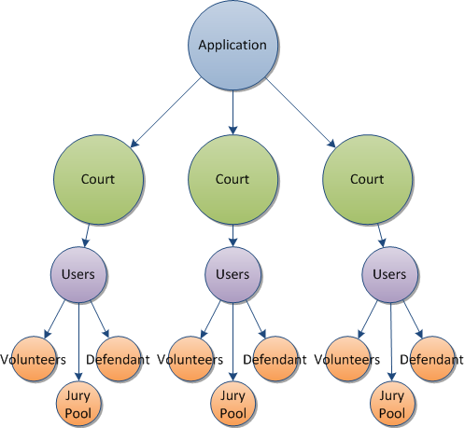
Application Components
Court Programs
Users and Access
Defendant
Volunteer
Jury Pool
Reports
Statistics
Surveys

Slide 16
Component – Court Program
Each court program accesses and data
Every user belongs to a court program
The National Association of Youth Courts has 1,050+ registered youth and teen court programs
Any of these could have an “area” setup for them
Each could have their own branding on the site
Ability to have their own custom data fields
Schools, cities covered, etc.

Slide 17
Component – User Access
Users will gain access using email address and password
Initial account created by:
Application Administrator
Can create any level
Court Administrator
Can create Court Managers and Court Users
Access only their data
Prompted to change password at first login

Slide 18
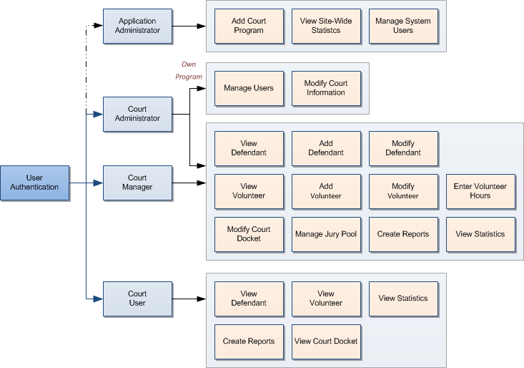
Component – User Access

Slide 19
Component – Defendant
Data Members
Personal Information
Parental Information
Citation Data
Intake Data
Court Lineup
Sentence Details
Workshop and Training Classes
Expunge Information
Actions
Add, Modify, Delete
Search

Slide 20
Component – Volunteer
Data Members
Personal Information
Contact Information
Actions
Add, Modify, Delete
Tracked data per trial
Volunteer Type
Date
Hours

Slide 21
Component – Jury Pool
Data Members
Active/Inactive
Personal Information
Contact Information
Comments
Jury Information
Date and Time
Location
Jury Hours
Actions
Add, Modify, Delete
Show active Jurors
Search Jury Pool

Slide 22
Component – Reports
Court Docket
Jury Summons
Sentence Report
Officer Status Report
Expungement Report
Case Notes
Workshop and Training Class Schedule
Volunteer Thanks Letter

Slide 23
Component – Statistics
Peer Court Activity
Volunteer Hours
Demographics
Case Log
Name Log

Slide 24
Component – Surveys
Ability to email surveys to application users
Gather specific data and feedback
Track and report any problems
Improve overall use of application

Slide 25
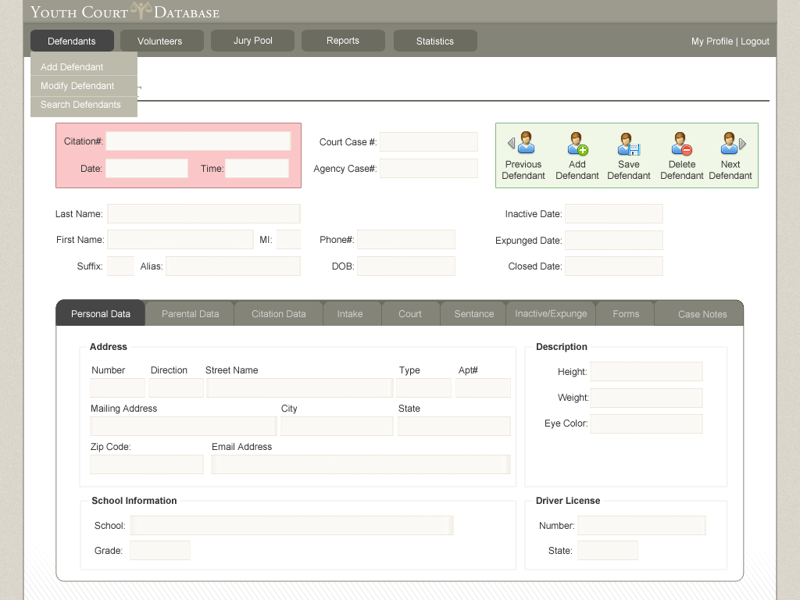
User Interface Concept

Slide 26
Testing
Unit testing will be utilized to cover all aspects of the program.
Will be done as classes are implemented.
Possibility of writing some test cases before implementation on certain data

Slide 27
Budget
Our budget is zero. Hence the name of our team!
Sponsor will cover costs of:
Web hosting
Domain name registration
Secure key certificate

Slide 28
Sprint 1 Summary
Deliverables
Mission Statement
Initial Software Development Agreement
Initial Software Requirements Document
Leftover Backlog
Domain Name and Hosting

Slide 29
Sprint 2 Backlog
Database Schema
Class Designs
User Interface Design
Continue documentation

Slide 30
Questions?

